Slide 1

Notes:
Will be discussing Innovation performance, Benefits and barriers across several industries

Slide 2





Where are we right now?
From ‘Why Australia Benchmark Report 2021’ by Australian Trade and Investment Commission we are,
CSIRO ranks in the
Top 1%
in worlds’ scientific institutions in 15/22 research fields
1st
technological readiness
3rd
# of universities in the worlds’ top 100
~47%
Australia workforce has a tertiary qualification
6th
Global entrepreneurship
Looks good. So nothing to worry about?
Notes:
Do not narrate on statistics

Slide 3
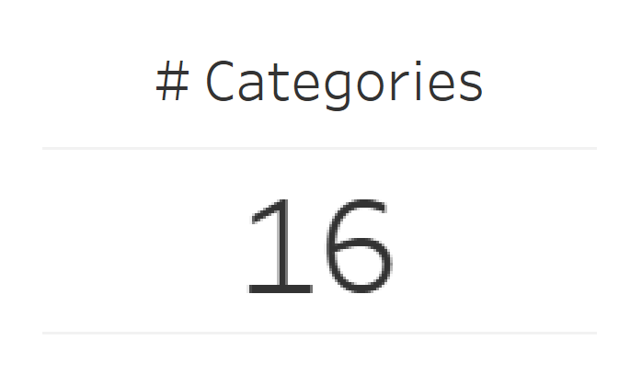
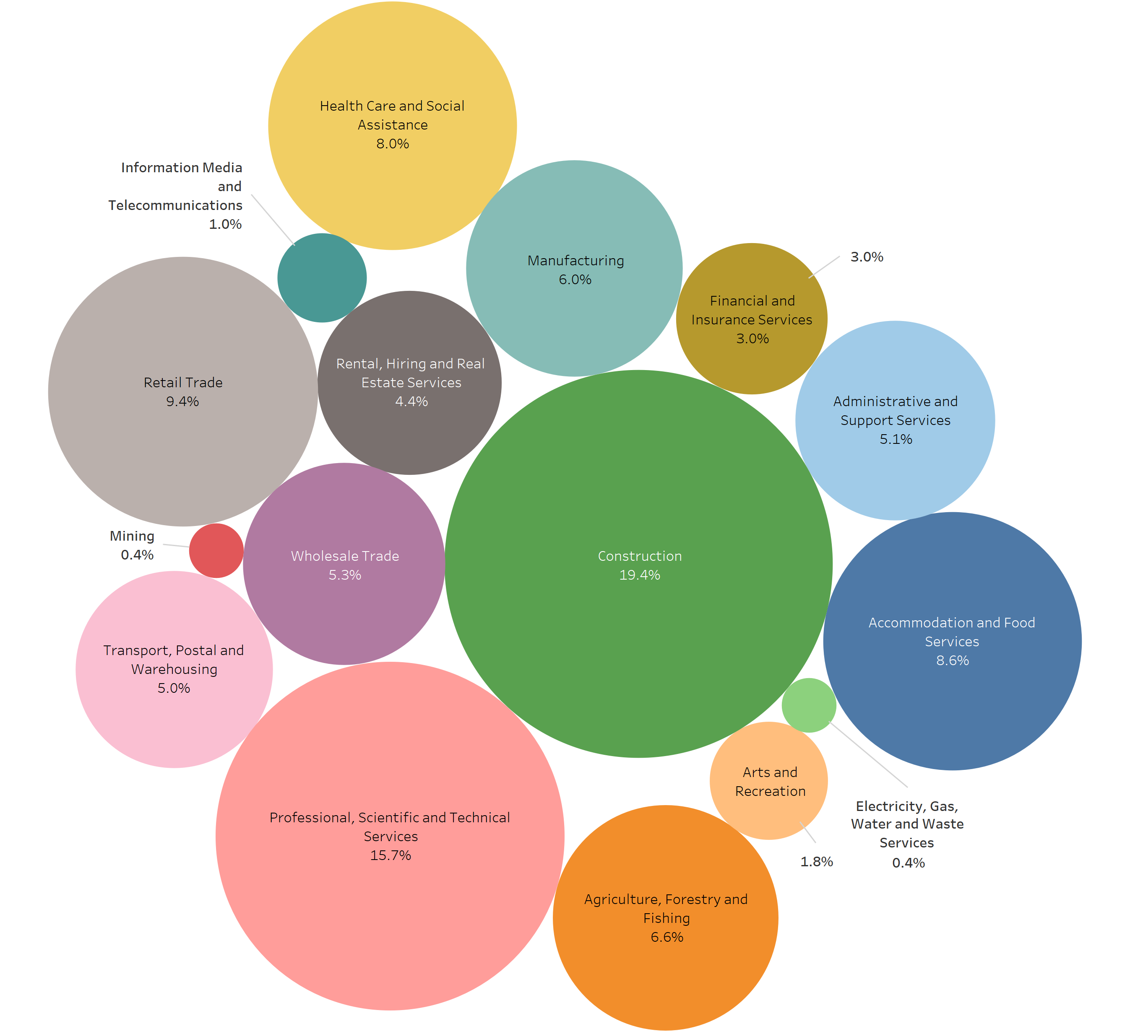
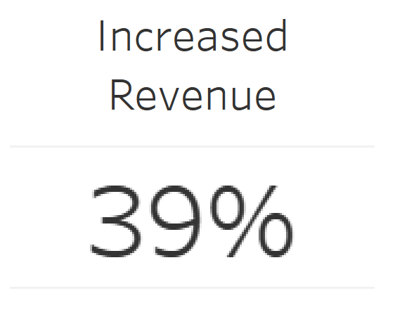
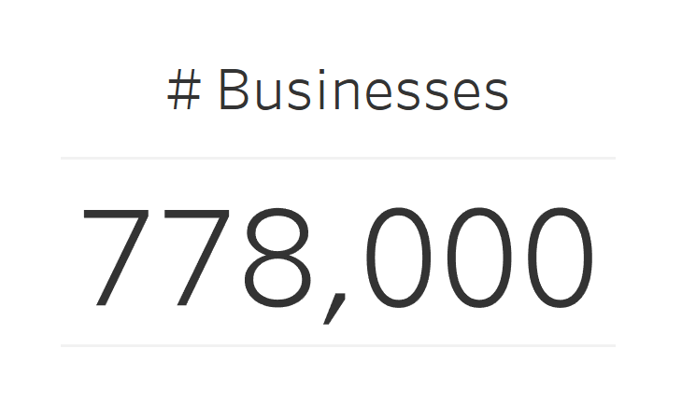
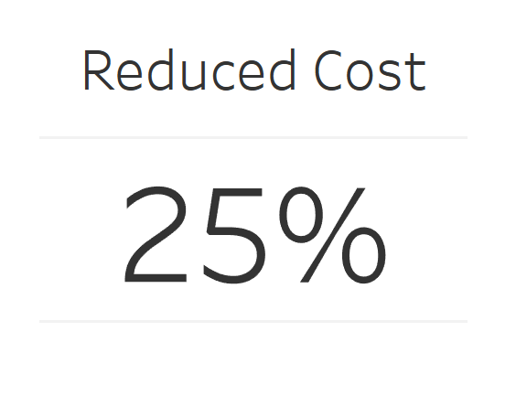
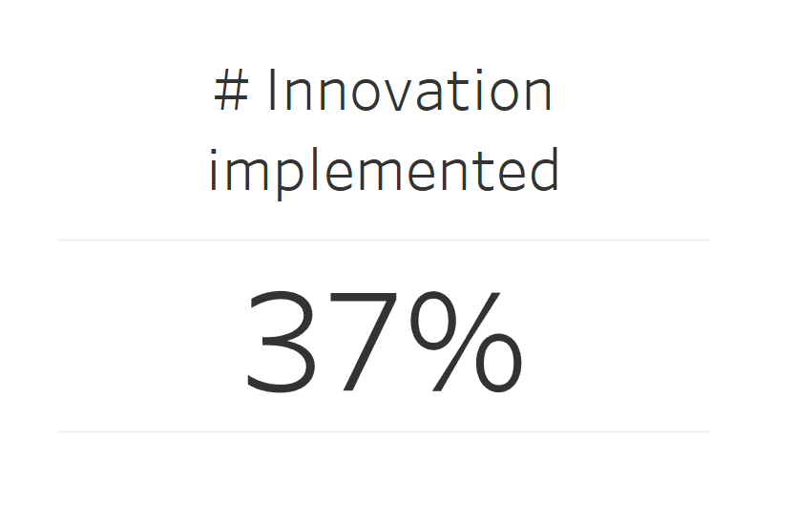
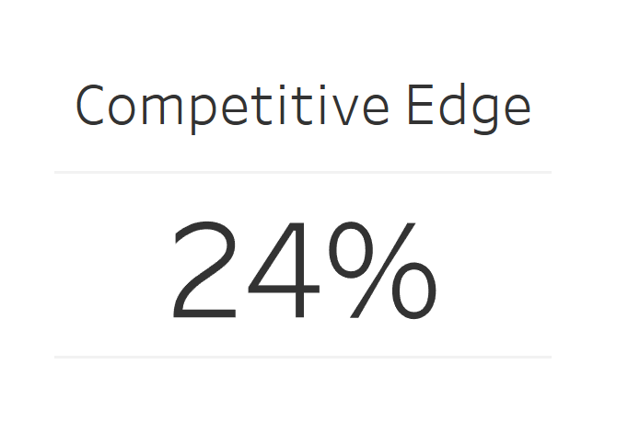
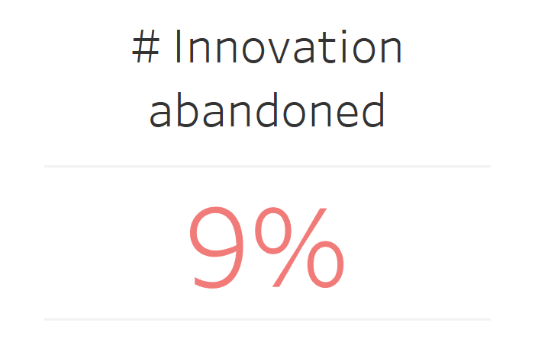
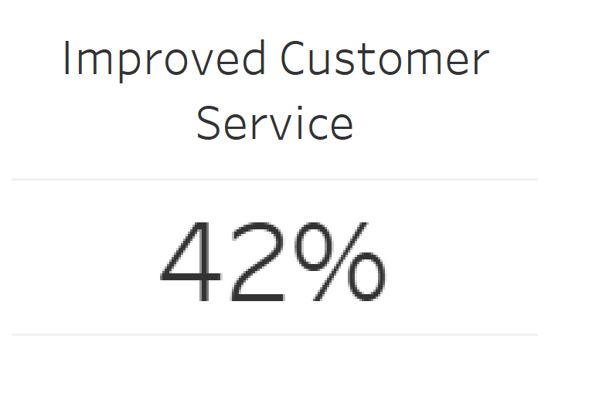
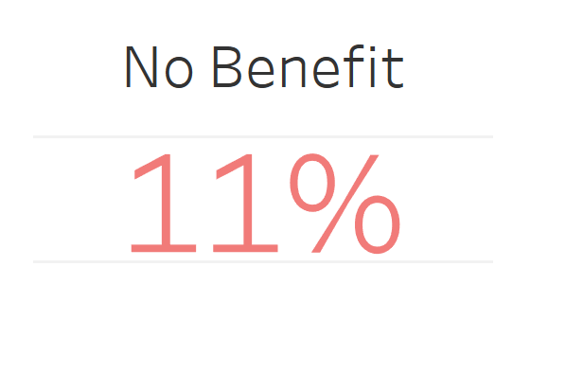
What are we looking at?
Notes:
Any benefits?

Slide 4
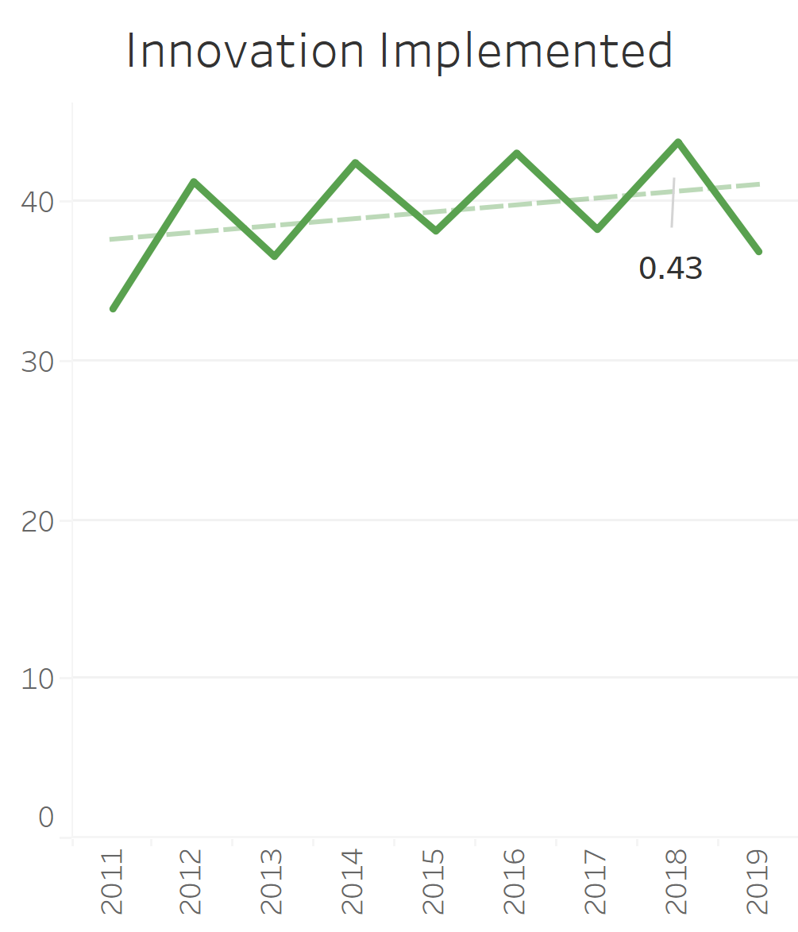
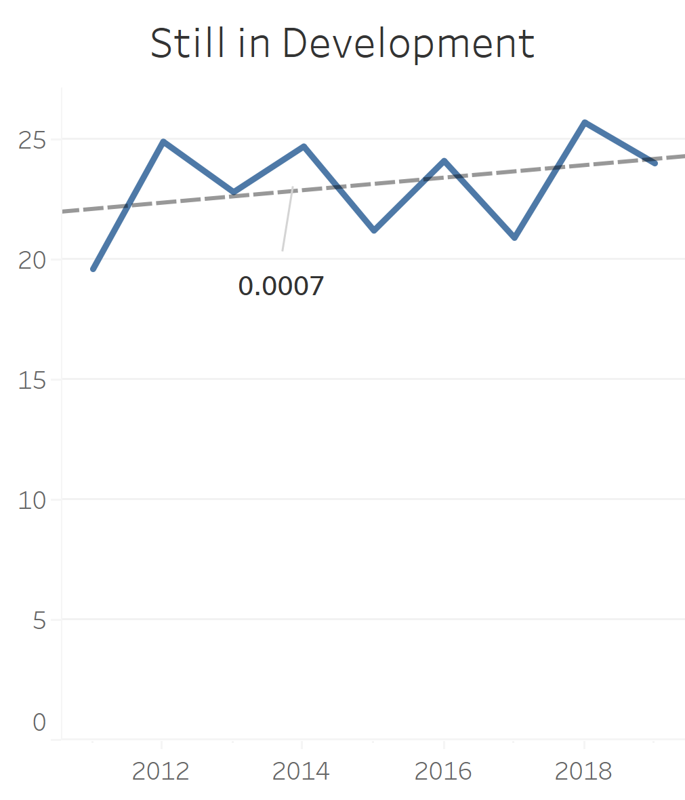
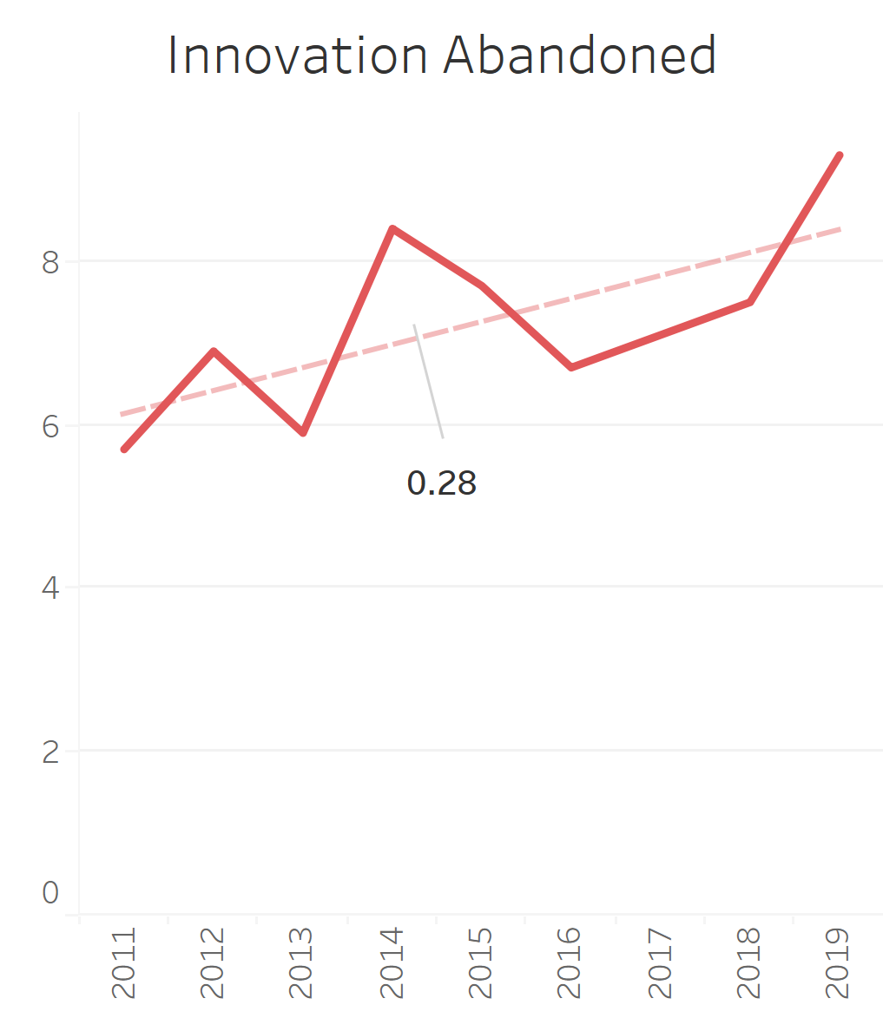
What happened over the years?
Innovation implemented Increase > Innovation abandoned increase
Companies are trying to innovate. But is it successful ?

Slide 5
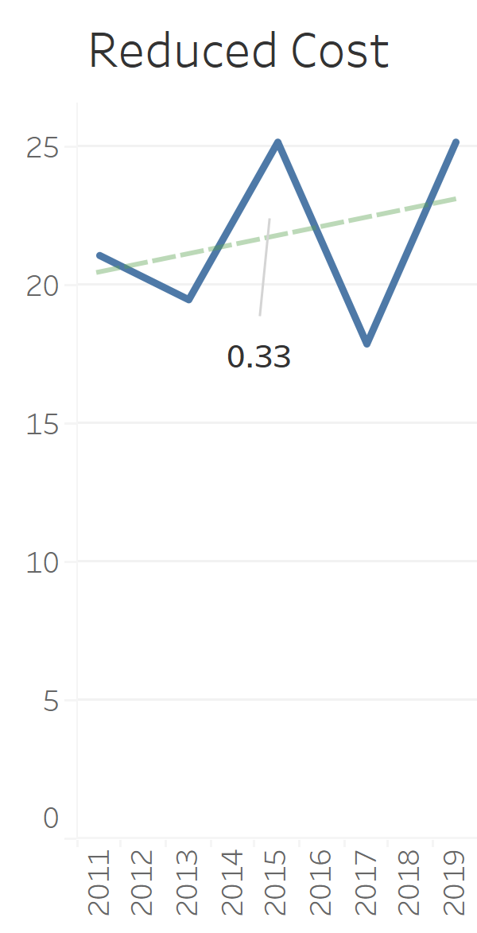
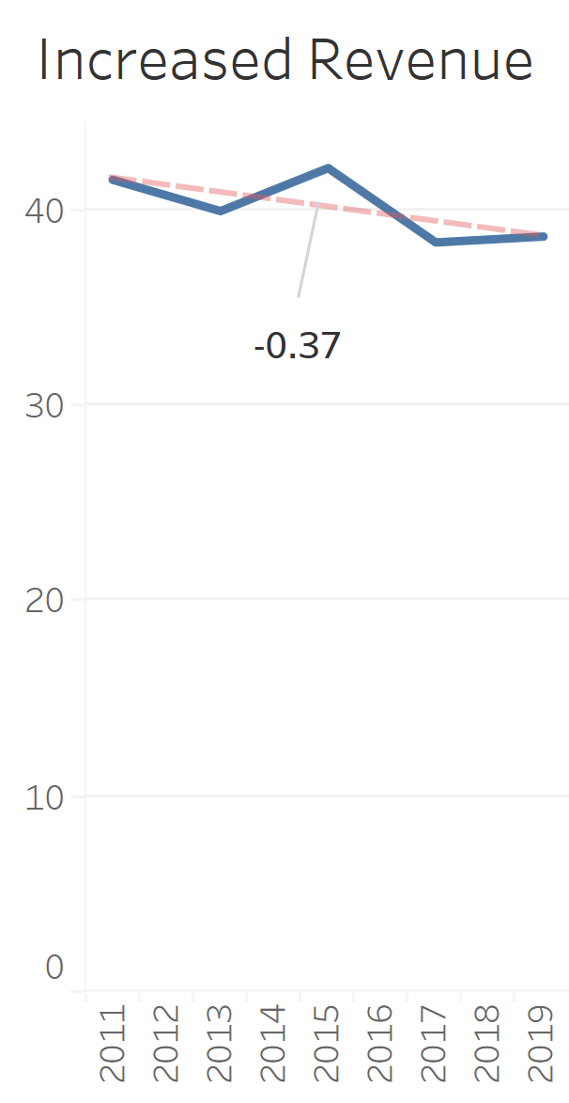
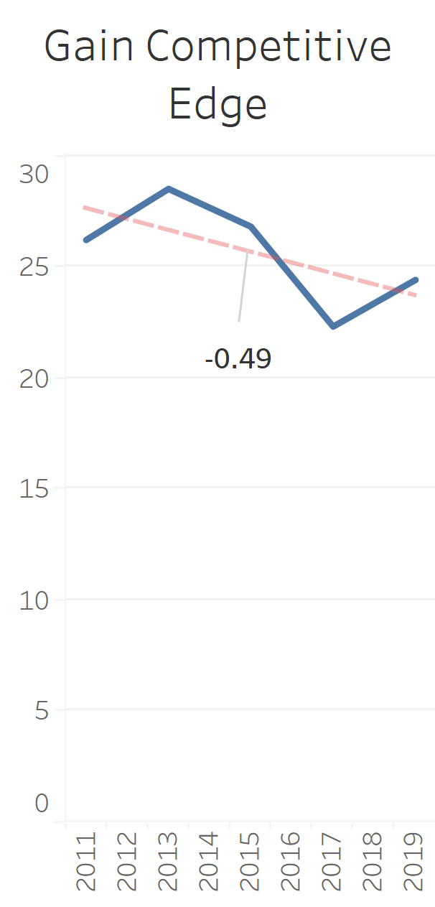
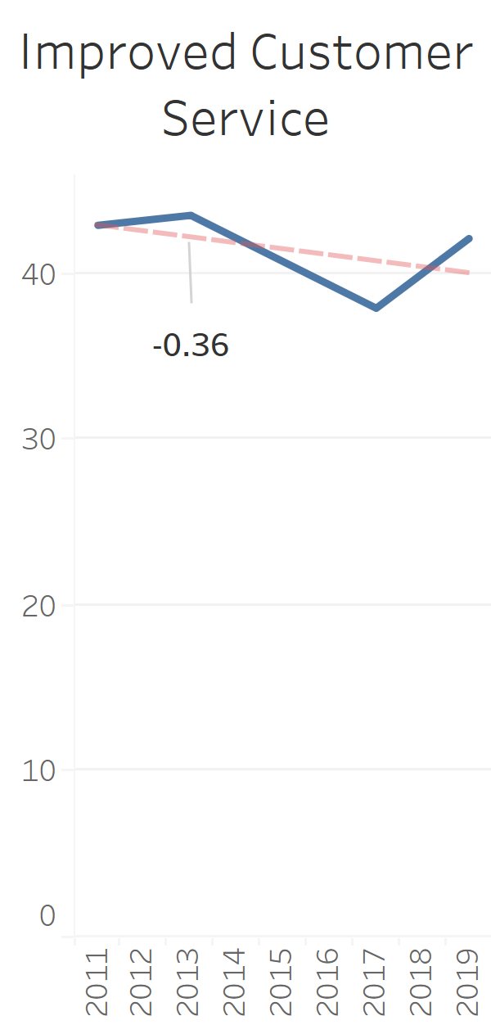
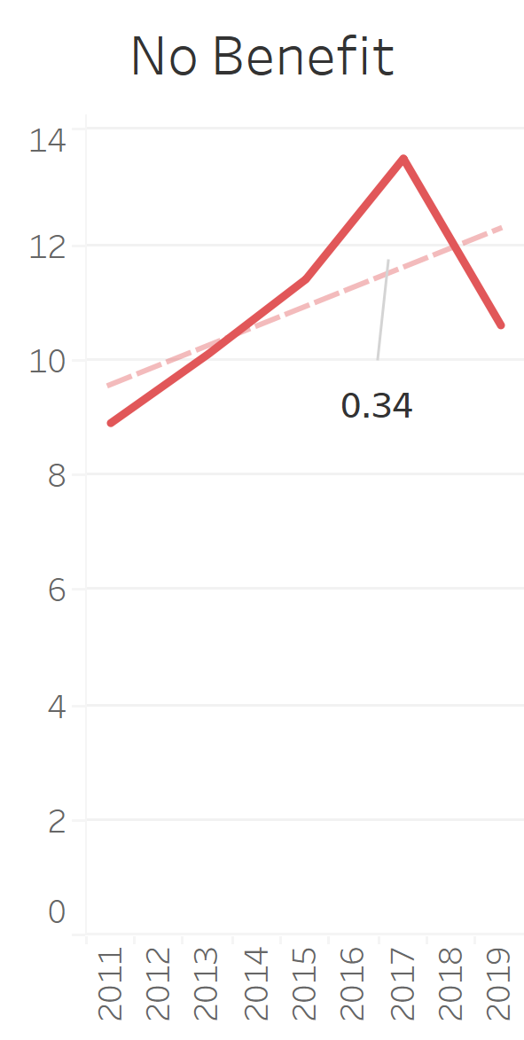
What happened over the years? – after the innovation has implemented
Implementation is there -> But success is a question

Slide 6
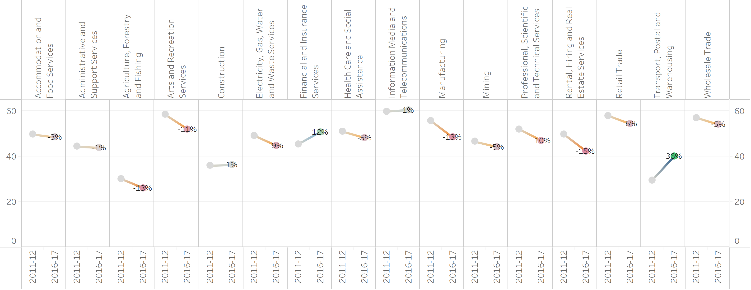
Industry-wise innovation activity over the years
Worst
Least
Best

Slide 7
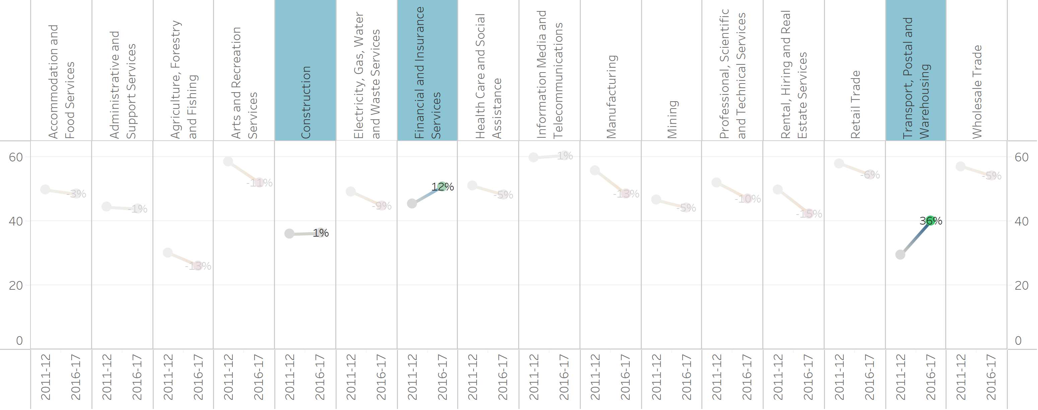
Industry-wise innovation activity over the years
3/16
Positive

Slide 8
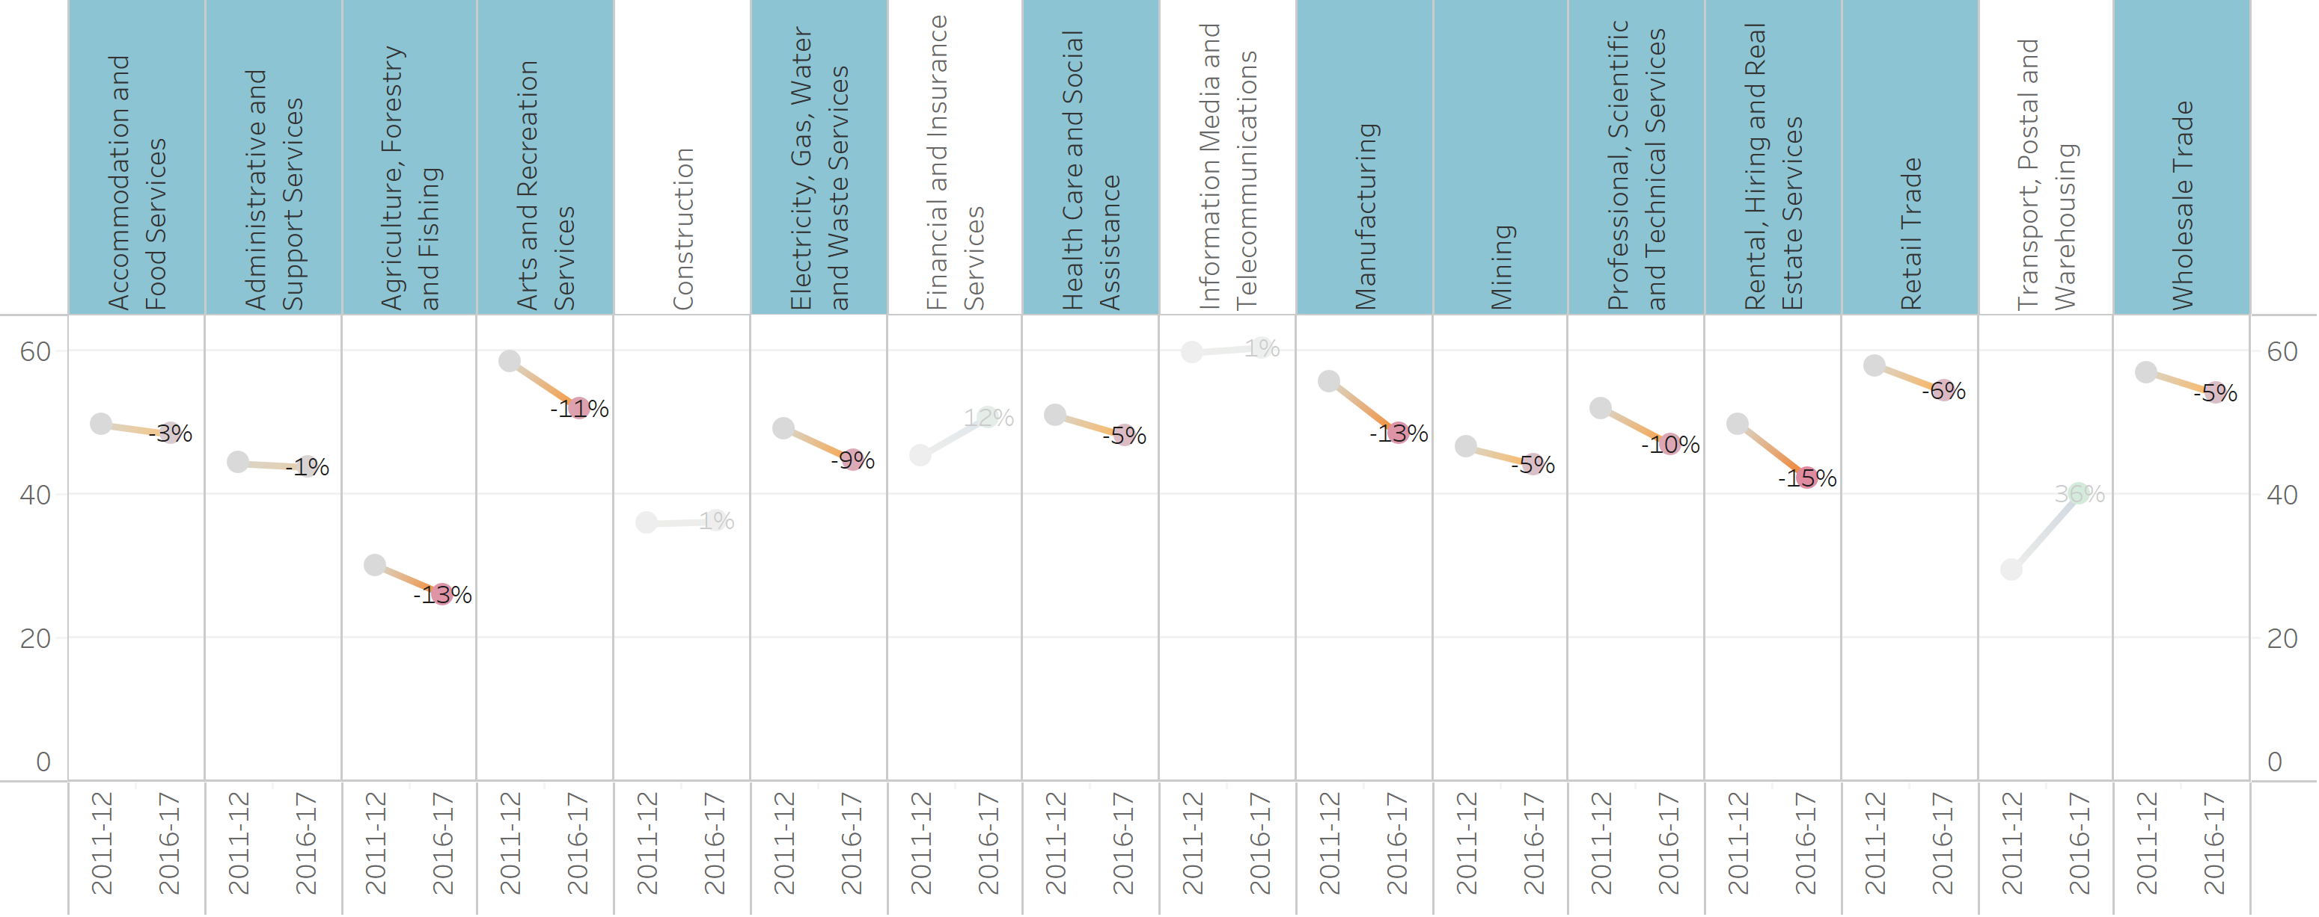
Industry-wise innovation activity over the years
12/16 Negative

Slide 9
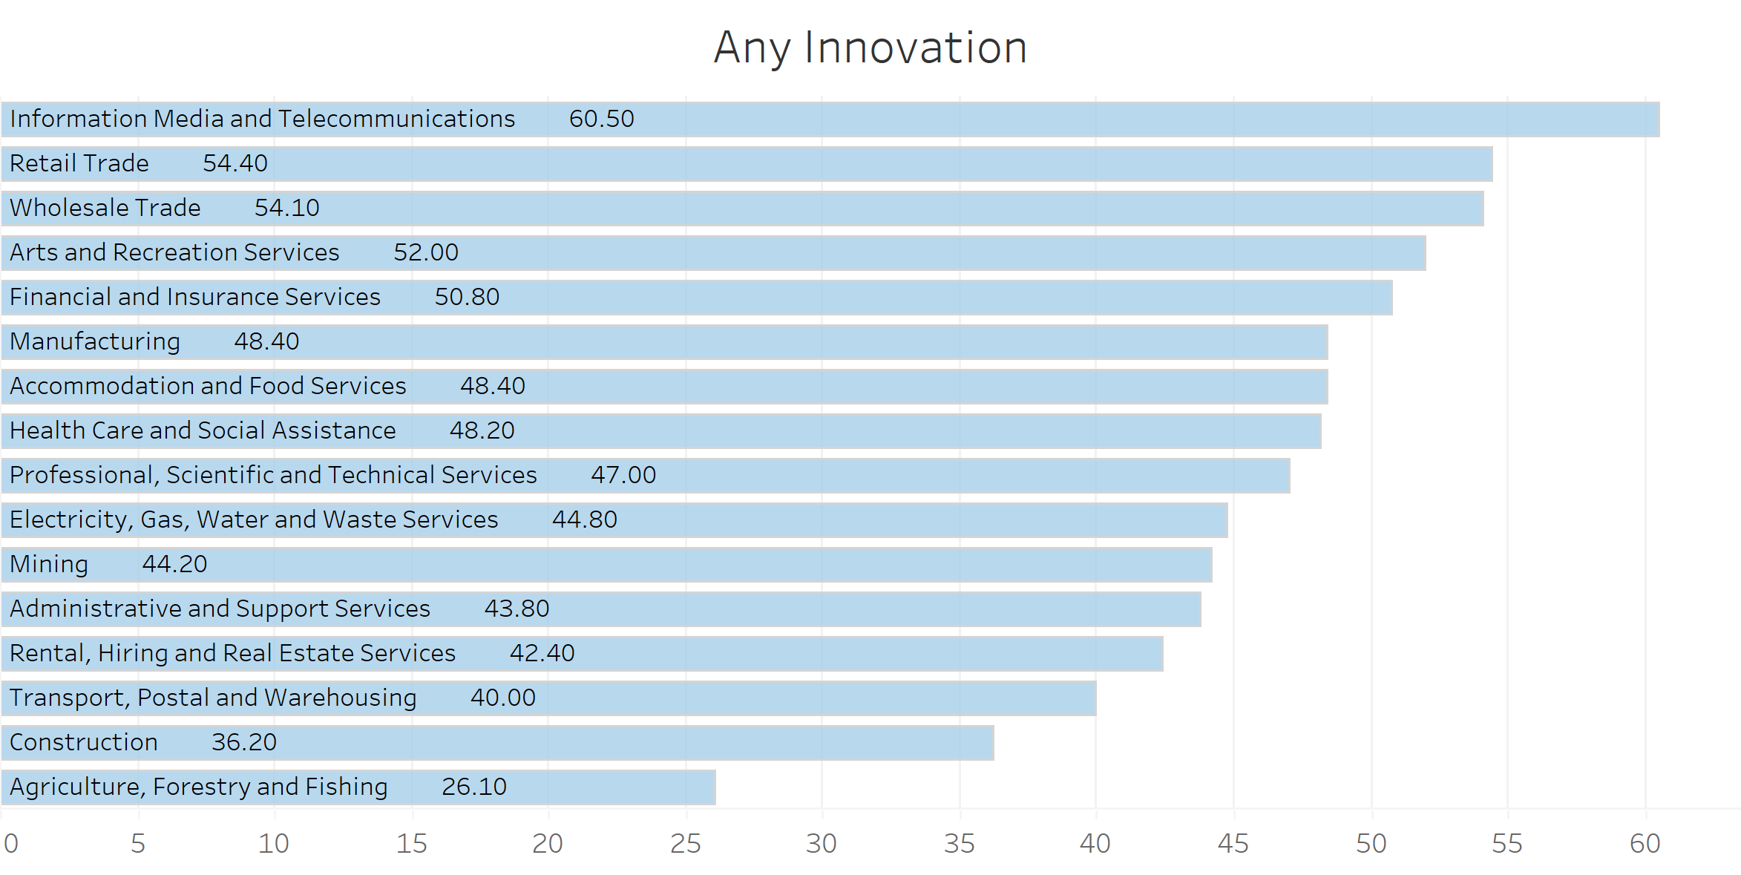
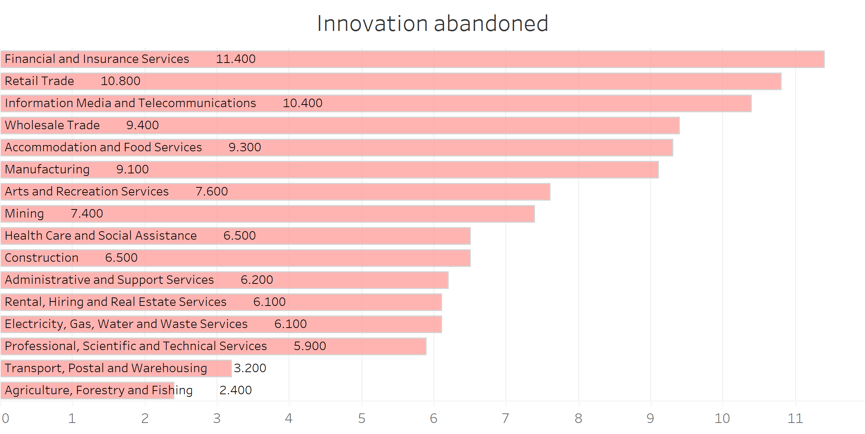
Industry-wise innovation done and abandoned?
Best
Worst
Worst
Best
Difference
Difference
Considerable differences among industries
Agriculture, Forestry and Fishing - > Worst inventor in terms of quantity

Slide 10
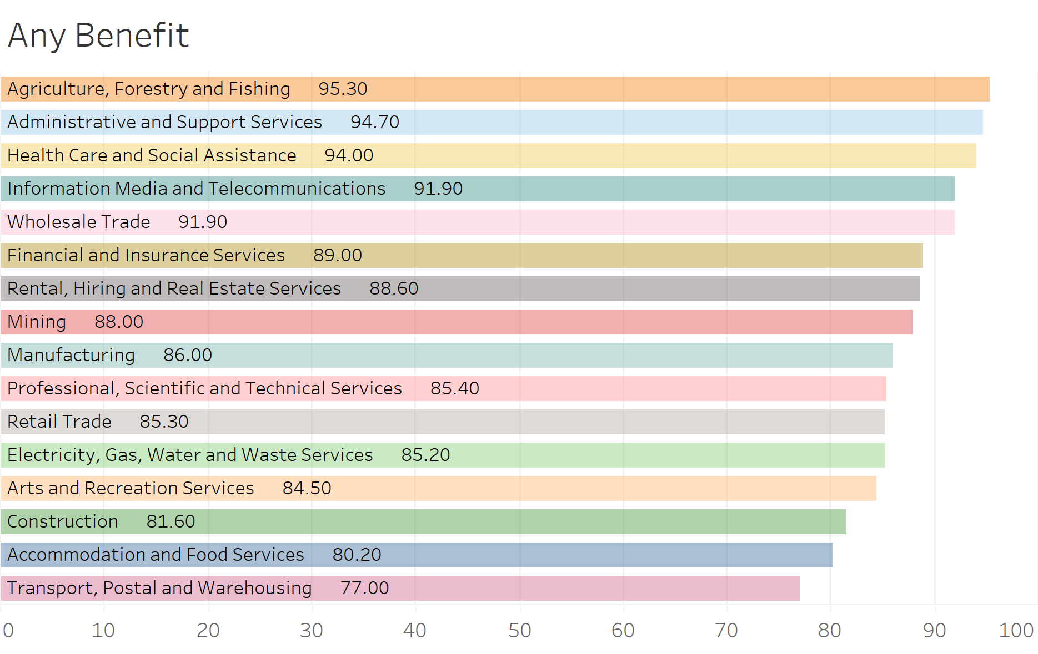
Innovation Benefits
Although Agriculture, Forestry and Fishing had less innovation activity,
they have benefitted the most

Slide 11
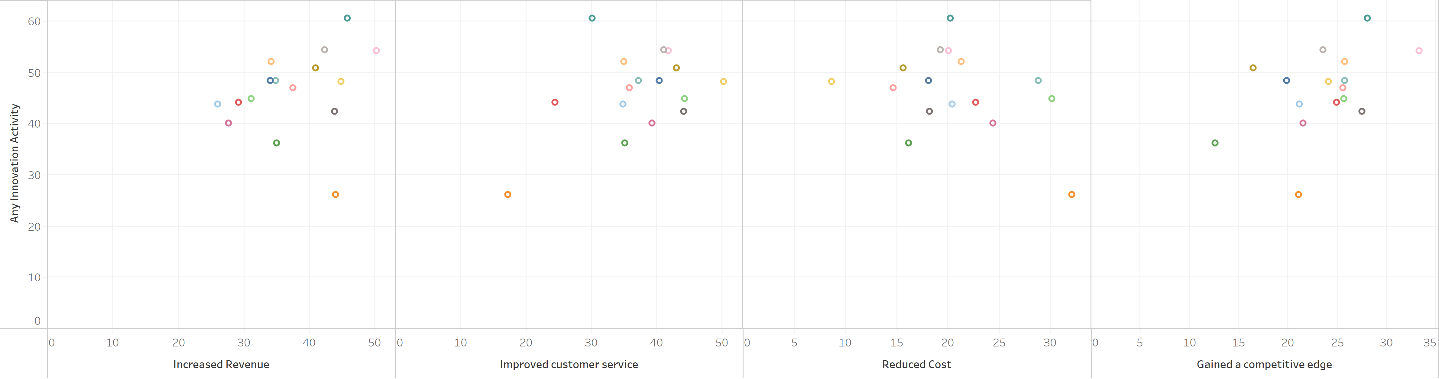
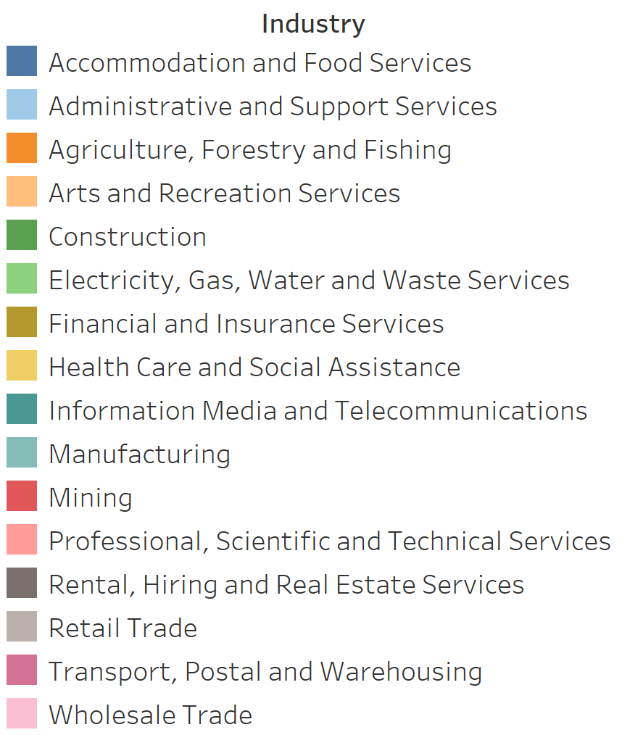
Innovation Benefits

Slide 12
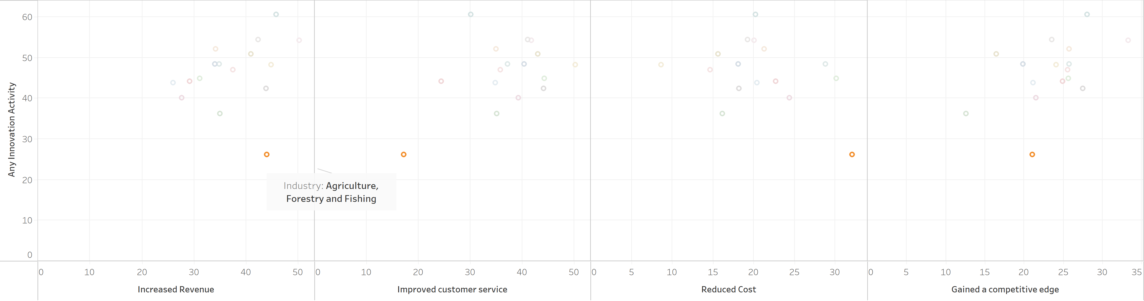
Innovation Benefits
From less innovations Agriculture, Forestry and Fishing has able to
increase revenue
reduce cost

Slide 13
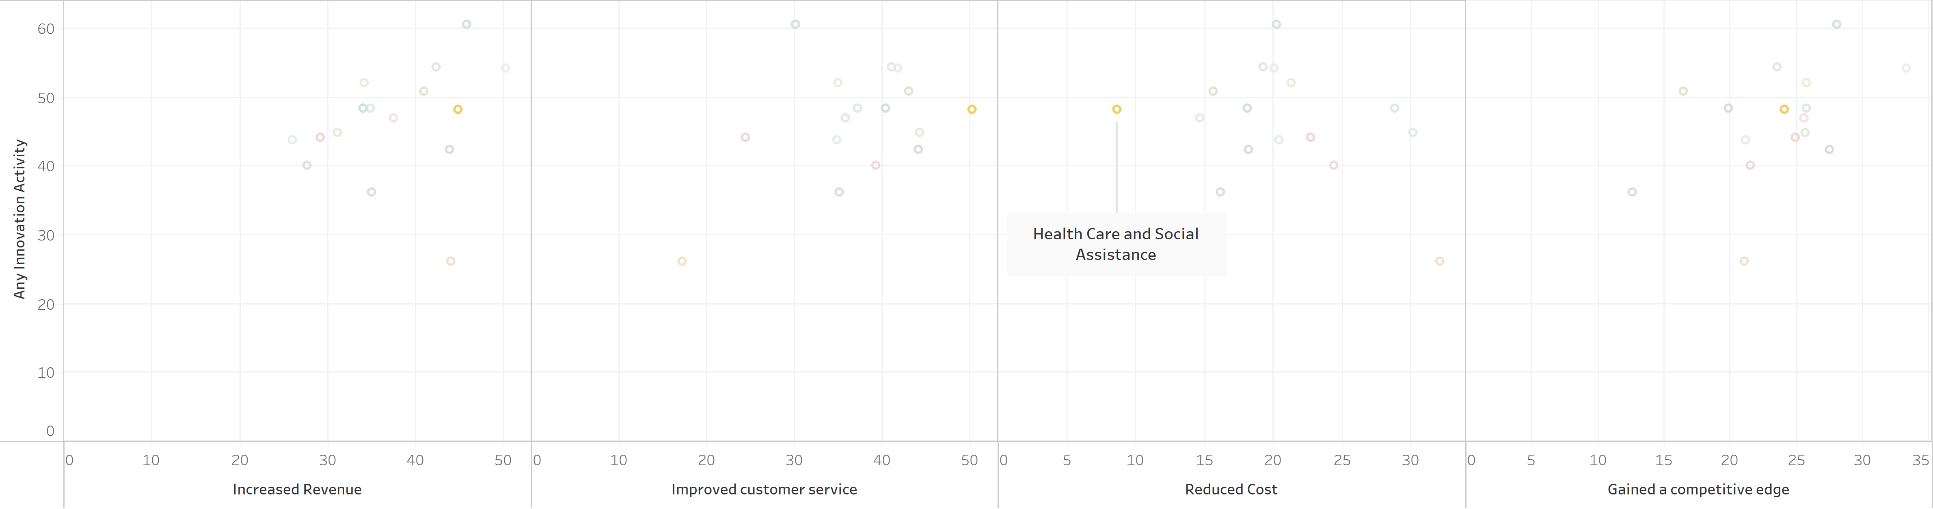
Innovation Benefits
With average innovation activity, Health Care and Social Assistance has gained considerable benefits except Reduced Cost.
In fact its way behind compared to other industries.

Slide 14
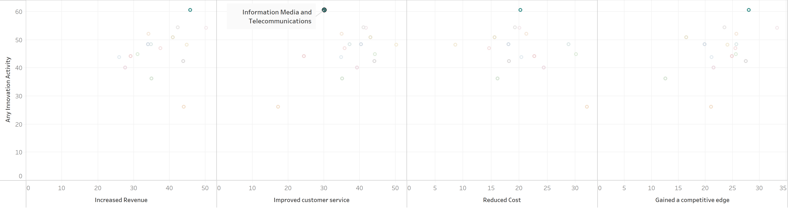
Innovation Benefits
With highest innovation activity Information Media and Telecommunications reap most benefits except,
- Improved customer service

Slide 15
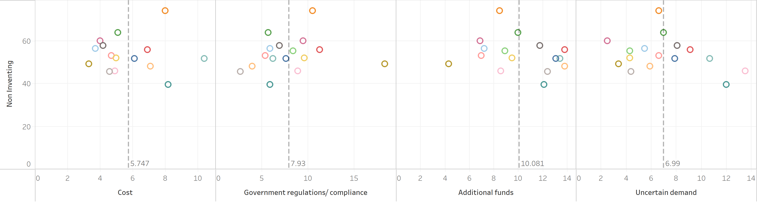
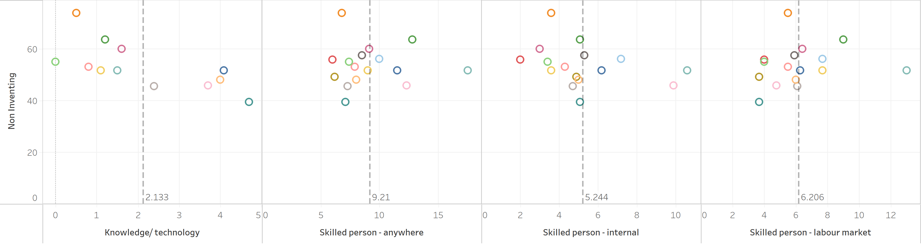
Barriers for Innovation
Additional funds, Skilled person (anywhere) -> Largest barrier
Knowledge/technology -> Smallest barrier

Slide 16
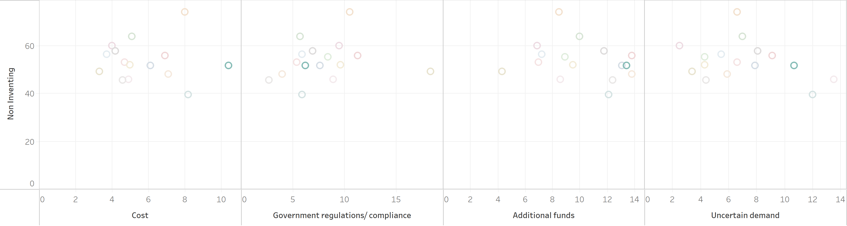
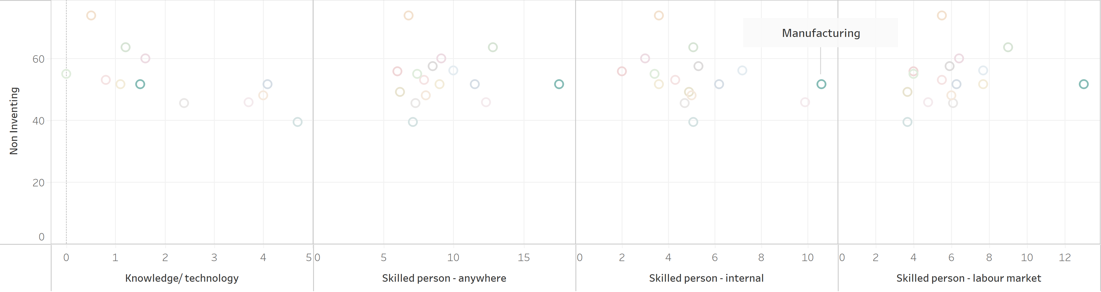
Barriers for Innovation
Manufacturing is highlighted in cost issues as well as skill shortage

Slide 17
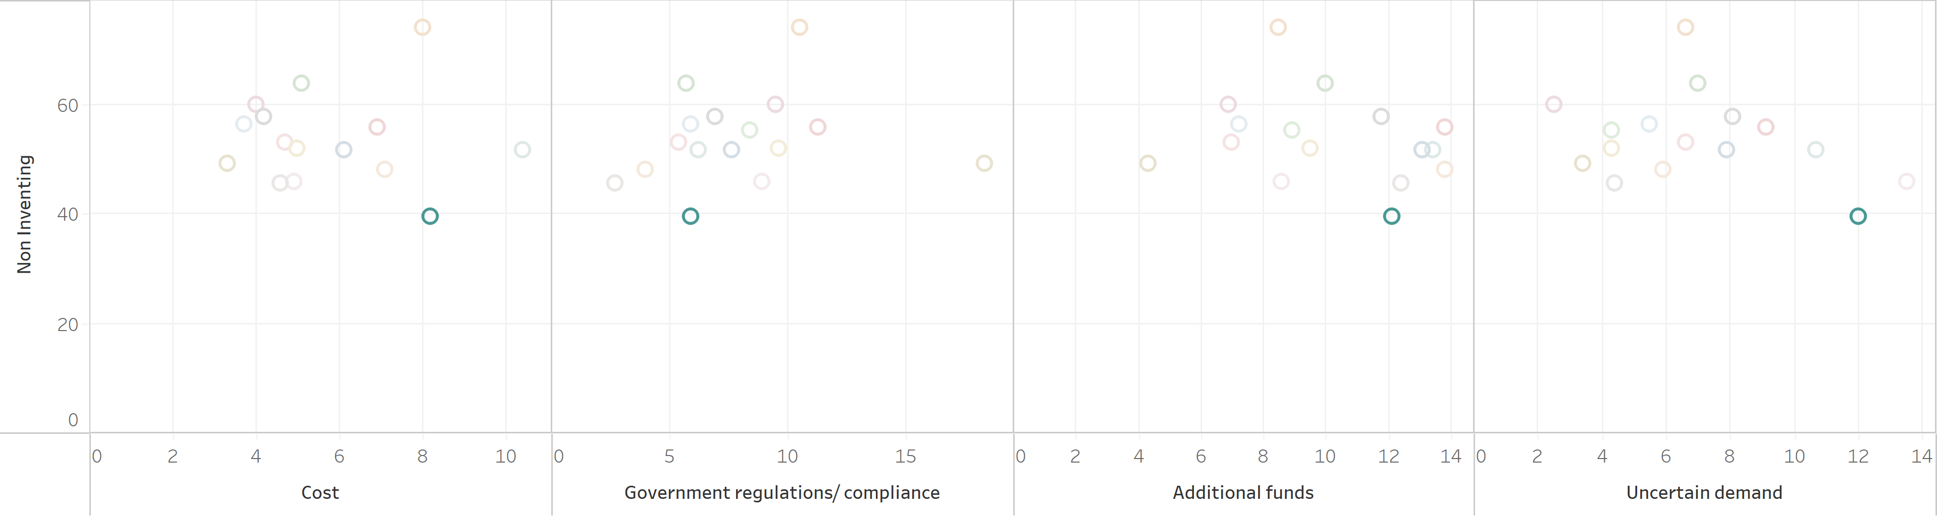
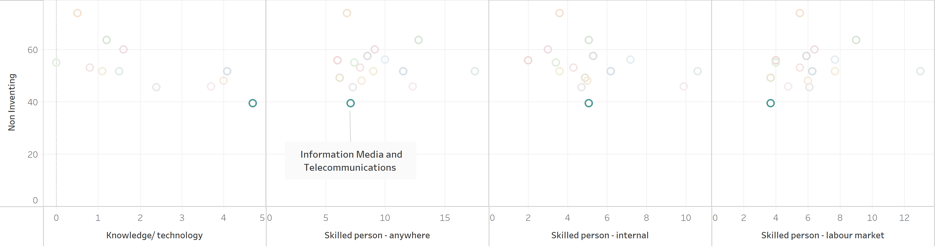
Barriers for Innovation
As best inventor, Information Media and Telecommunication -> very less skill shortage
Might indicate that skill market has identified the demand correctly

Slide 18
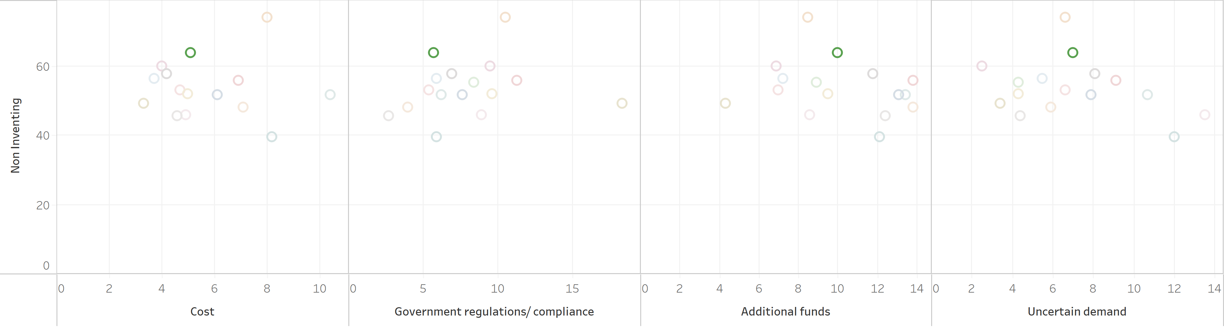
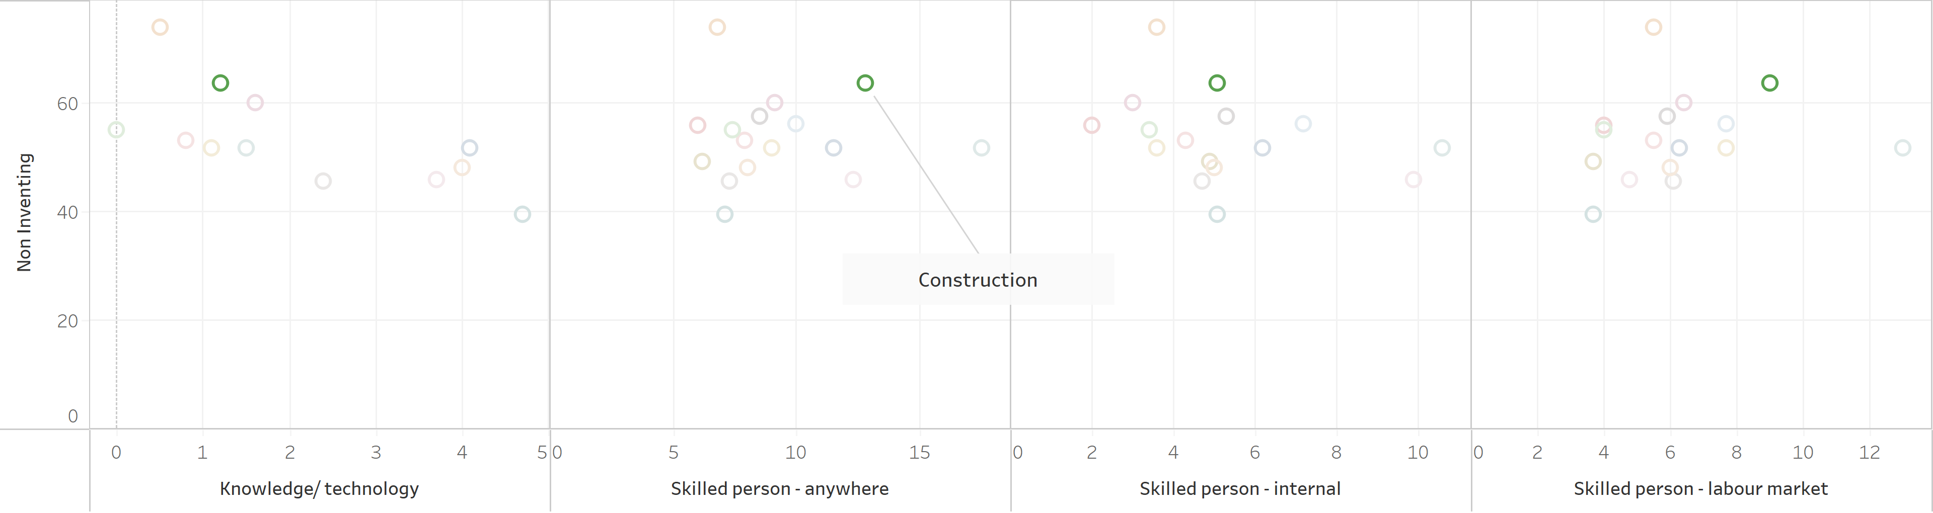
Barriers for Innovation
As opposed to , Information Media and Telecommunication, Construction has a visible shortage of skills

Slide 19
Conclusion
Business innovation in Australia is strong.
Overall, number of innovations are improving over the years. But benefits are decreasing.
Hence will require additional programs to improve the quality of the innovations.
Vast differences are there in innovation quality and quantity among different industries.
Industries such as Agriculture, Forestry and Fishing had good success from limited number of inventions. Need further research on finding reasons and to implement those solutions across.
Some industries such as Information Media and Telecommunications, labour market has identified market demand for skills.
This is not true for some industries such as Manufacturing. Need further research on finding reasons.

Slide 20
References
Data and information
Department of Industry (2018) Business Innovation, Available at: https://publications.industry.gov.au/publications/australianinnovationsystemmonitor/business-innovation/index.html (Accessed: 14th June 2021).
Australian Bureau of Statistics (2018) Innovation in Australian Business, Available at: https://www.abs.gov.au/statistics/industry/technology-and-innovation/innovation-australian-business/2016-17#data-download (Accessed: 2nd June 2021).
Australian Trade and Investment Commission (2021) Why Australia Benchmark Report 2021, , Available at: https://www.austrade.gov.au/benchmark-report/innovation-skills (Accessed: 18th June 2021).
Cover image
https://www.jing.fm/iclip/hJobTm_toolbox-clipart-technology-subject-icon-smart-city-png/
Icon Images
https://www.cleanpng.com/
https://www.clipartmax.com/

